Slide 1




Predicting Ice Bed Topography using Machine Learning Homayra Alam, Omar Faruque, Sikan Li, Jianwu Wang, Mathieu Morlighem

Slide 2

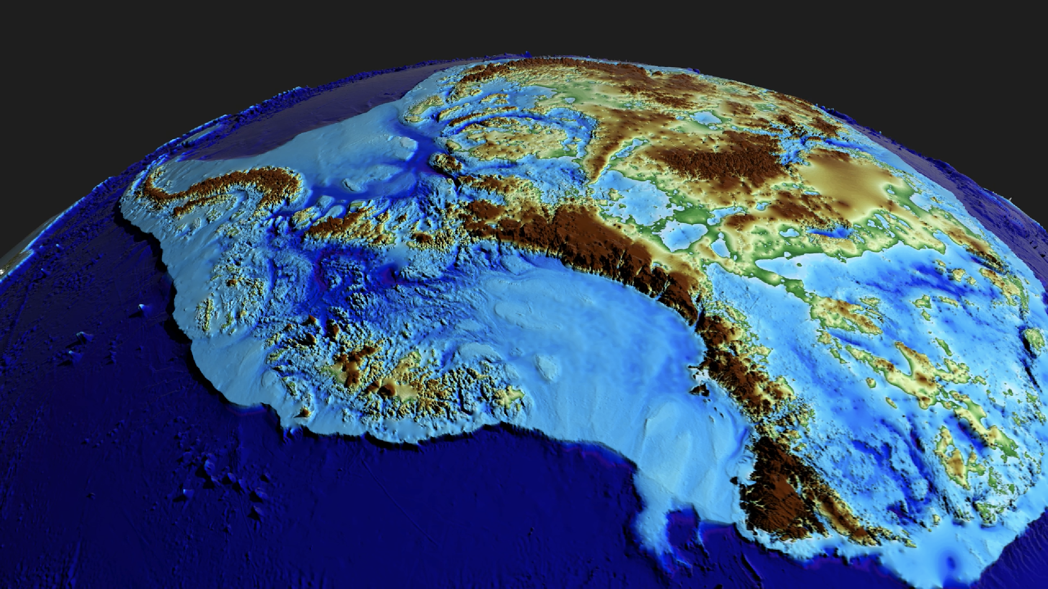
Can we use AI to map
the landscape hidden under the ice sheet
based on what we see at the surface?
Notes:
Sea levels are rising as a result of the melting of the Greenland
Ice Sheet (GrIS). Computer models are used to precisely
anticipate how these ice sheets will be affected by climate
change. The structure of the bedrock beneath the ice,
however, has a significant impact on how reliable these models
are. Thus, having a precise depiction of the bed topography
is essential. Due to scarce measurements, bed topography
data are currently incomplete, hence it is important to
build methods for addressing these data gaps.

Slide 3
Science needs
Bed controls the stability and vulnerability of the ice sheet
Consistently ranked #1 need by ice sheet modelers
Radar measurements remain sparse

Slide 4
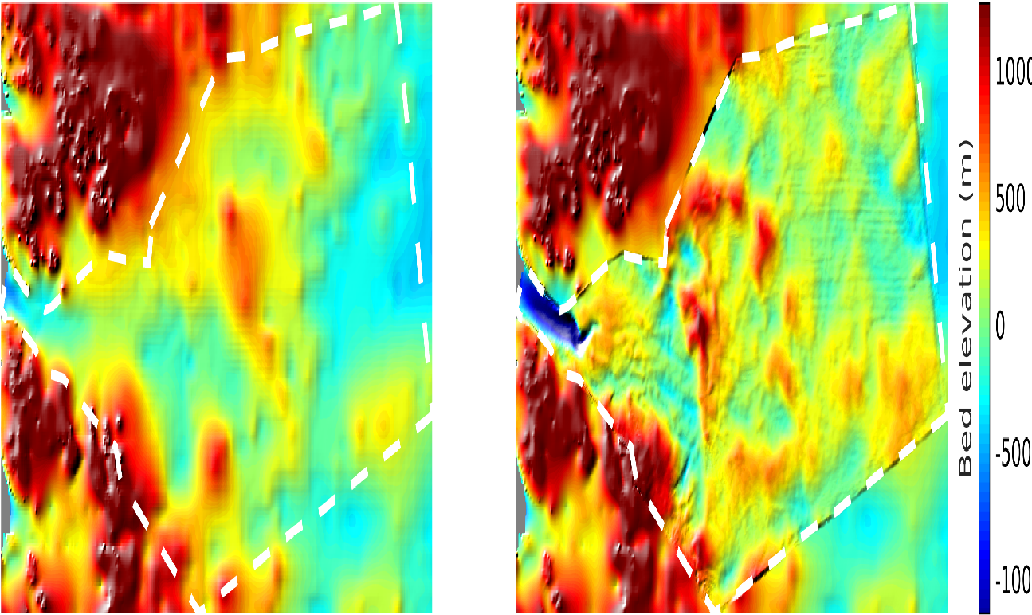
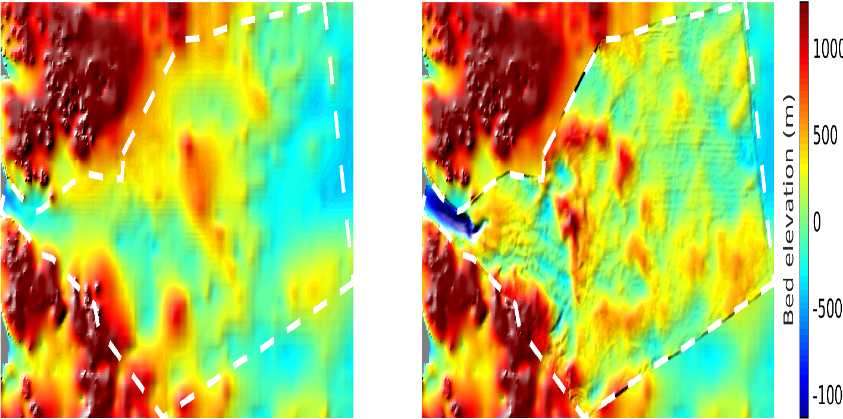
Related work
Bedmap 2
BedMachine Antarctica
1000
500
0
-500
-1000
Morlighem, M., Rignot, E., Binder, T. et al. Deep glacial troughs and stabilizing ridges unveiled beneath the margins of the Antarctic ice sheet. Nat. Geosci. (2019) doi:10.1038/s41561-019-0510-8

Slide 5
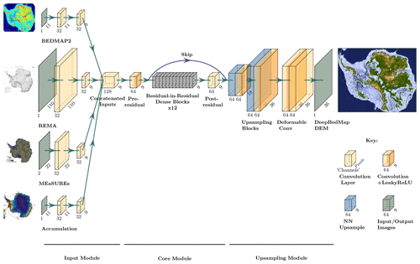
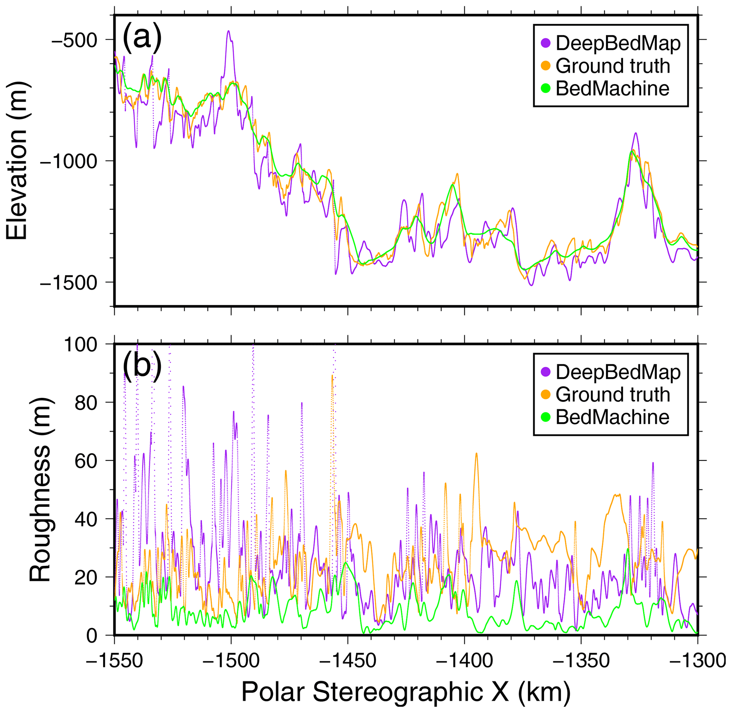
Related work
Leong, W. J. and Horgan, H. J.: DeepBedMap: a deep neural network for resolving the bed topography of Antarctica, The Cryosphere, 14, 3687–3705, https://doi.org/10.5194/tc-14-3687-2020, 2020.

Slide 6
Proposed Approach
Train a Neural Network to infer the shape of the bed based on information at the surface:
Surface elevation
Surface speed
Surface mass balance
Thinning rates

Slide 7
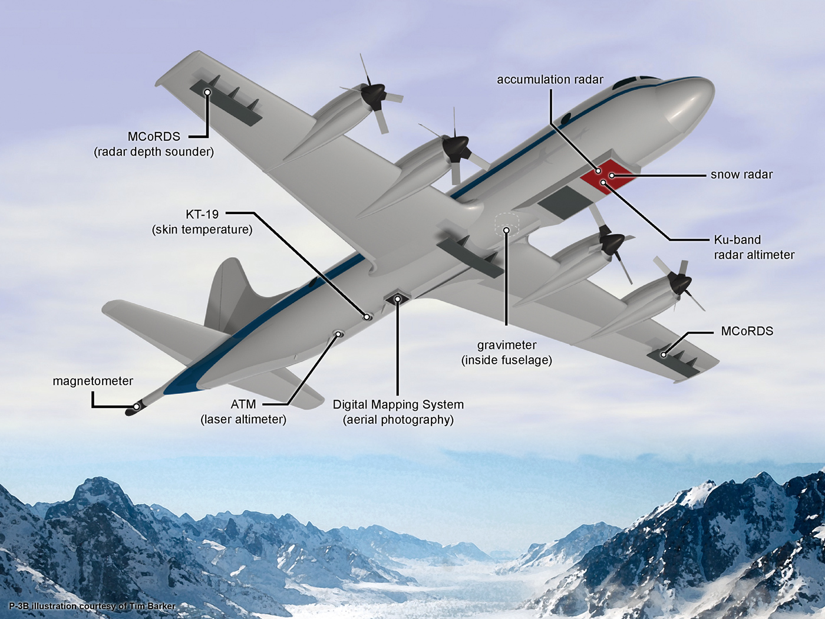
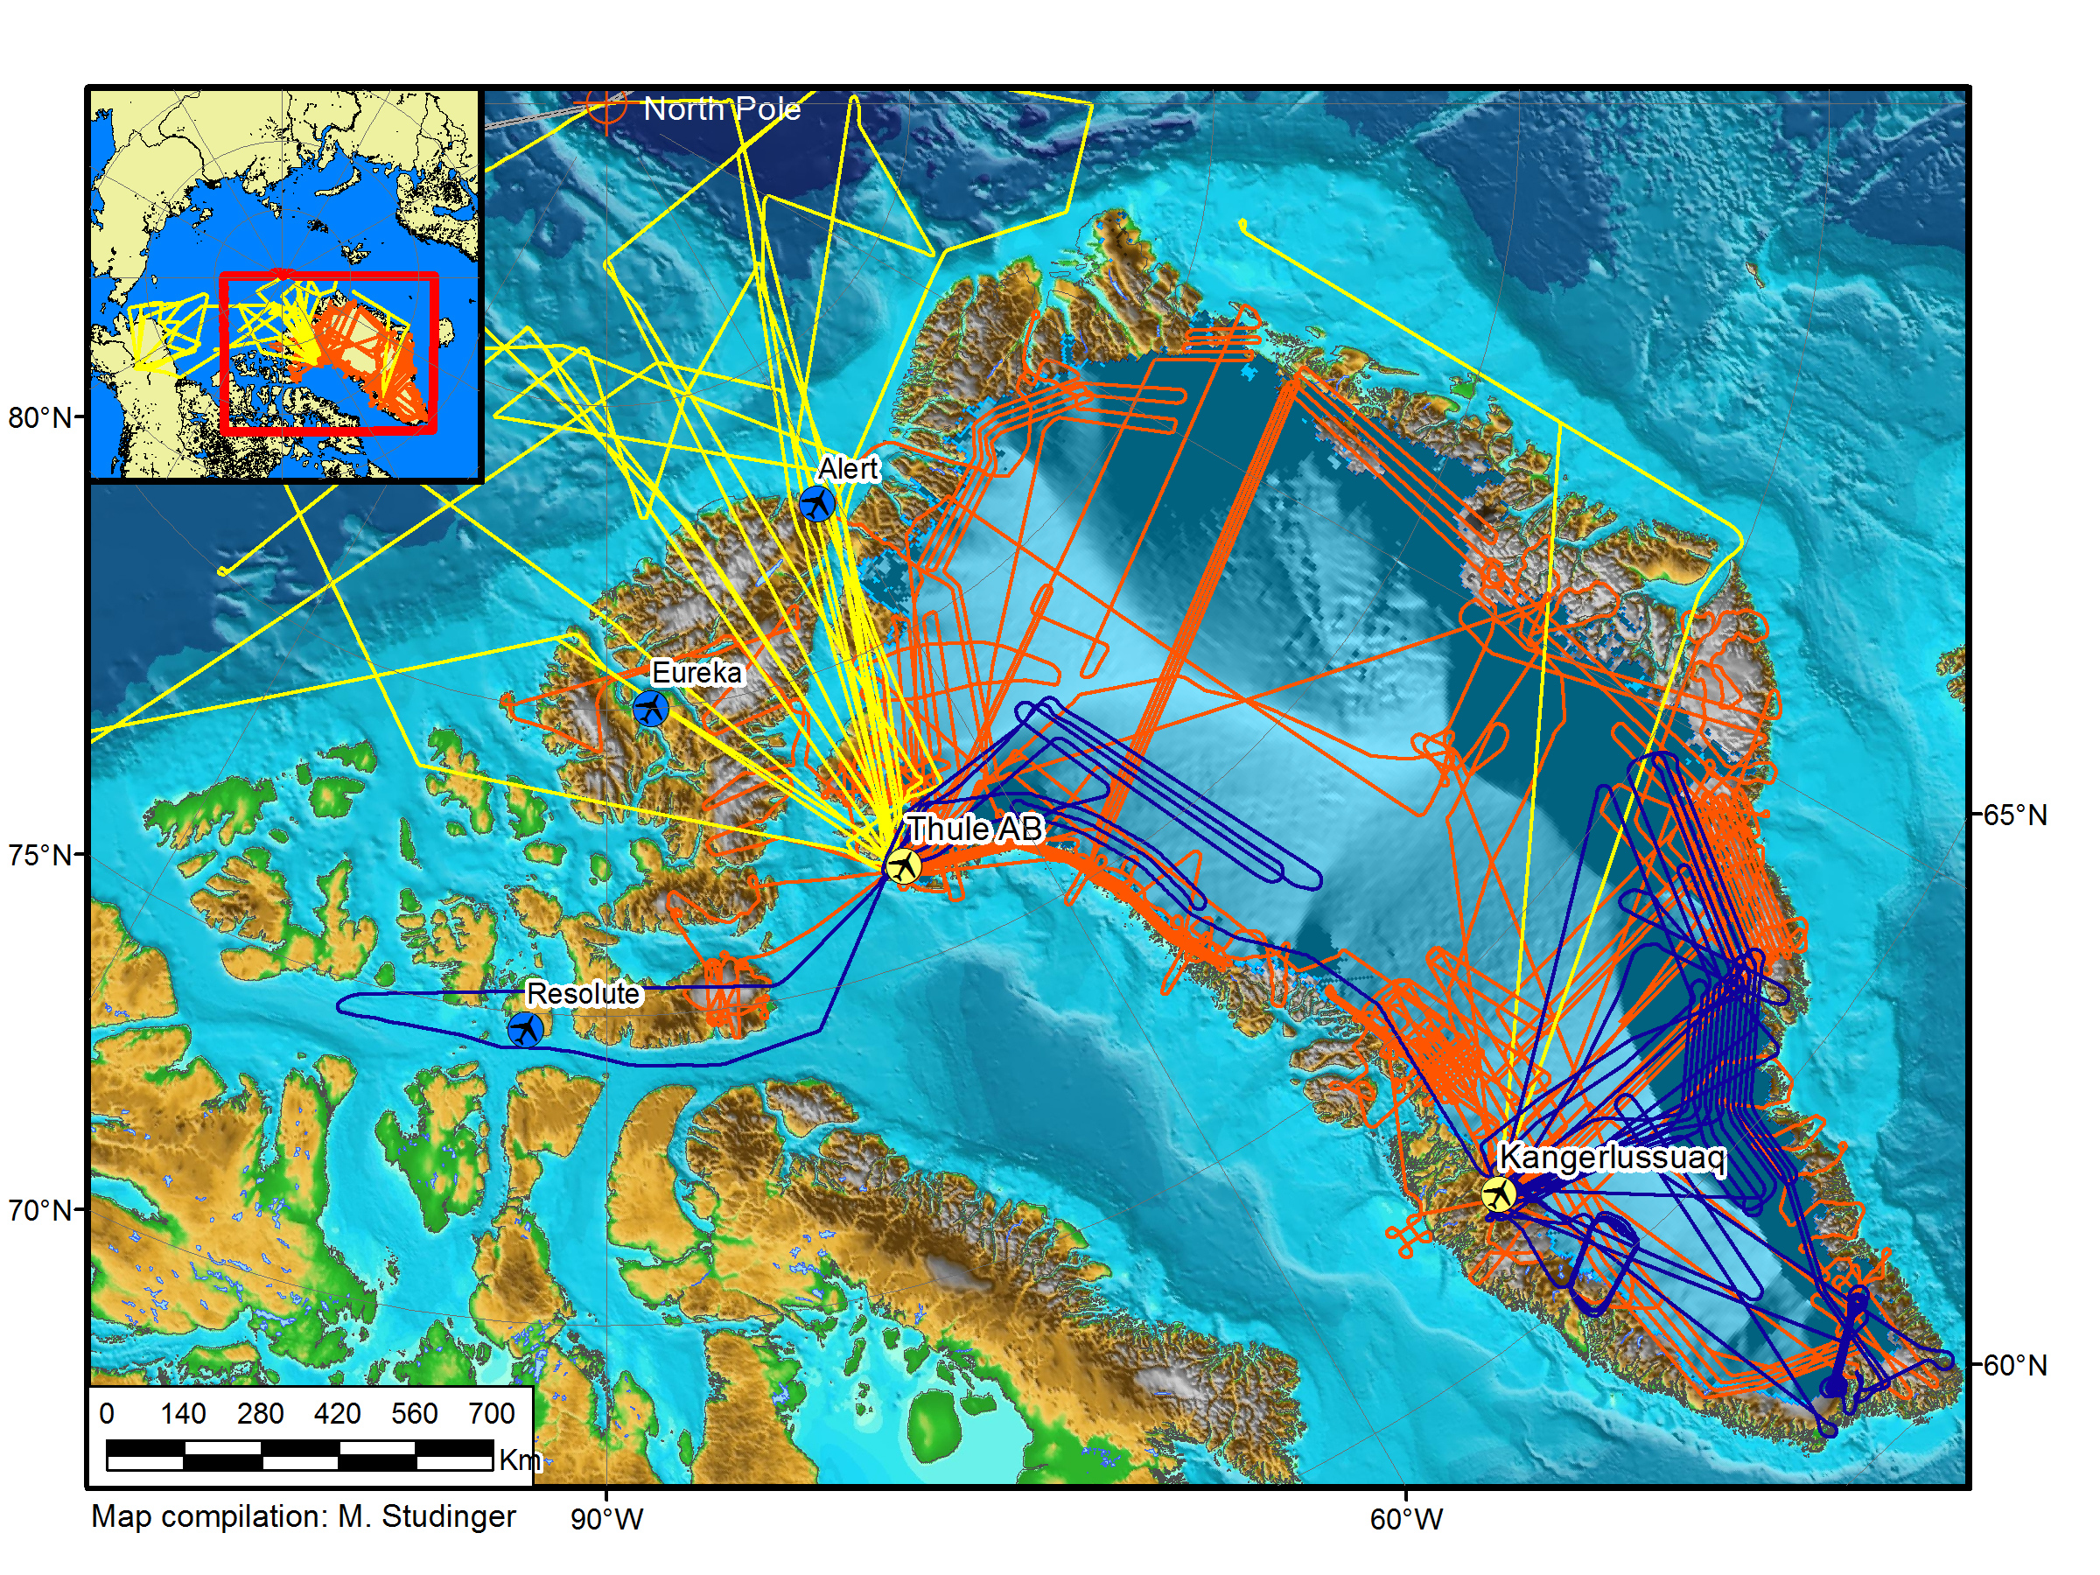
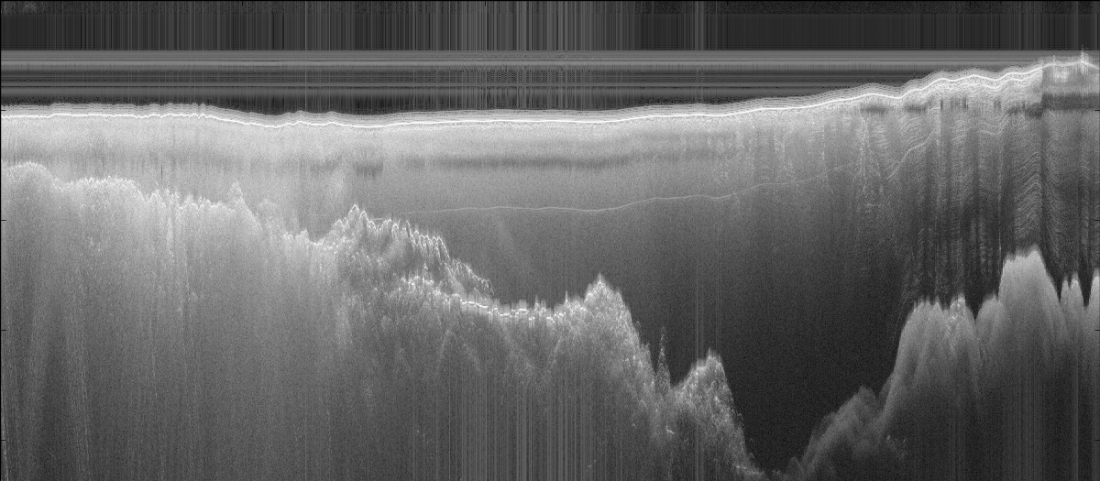
Training set: Ice penetrating radar data
NASA P-3
Flight lines OIB Arctic 2012
Radar echogram
Air
Ice thickness
ocean
bedrock

Slide 8
Feature Collection of the Dataset
MEaSUREs ice surface velocity: https://nsidc.org/data/nsidc-0478/versions/2 (MEaSUREs Greenland Ice Sheet Velocity Map from InSAR Data, Version 2)
BedMachine bed topography https://nsidc.org/data/nsidc-0756/versions/3 (MEaSUREs BedMachine Antarctica, Version 3)
Surface topography from GIMP https://nsidc.org/data/nsidc-0715/versions/1 (MEaSUREs Greenland Ice Mapping Project (GIMP) Digital Elevation Model from GeoEye and WorldView Imagery, Version 1)

Slide 9
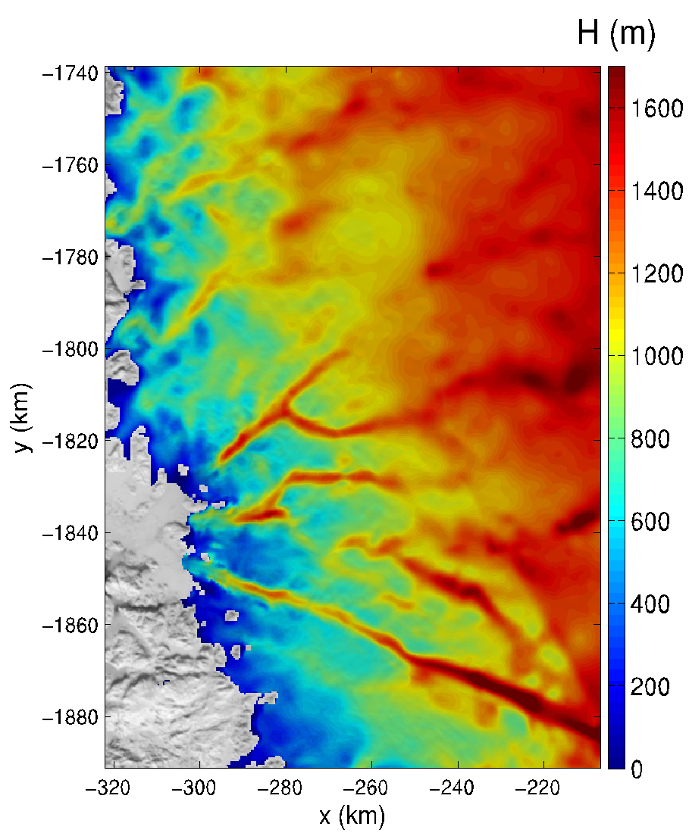
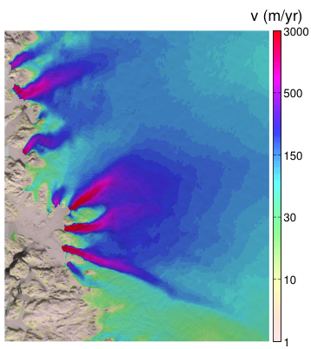
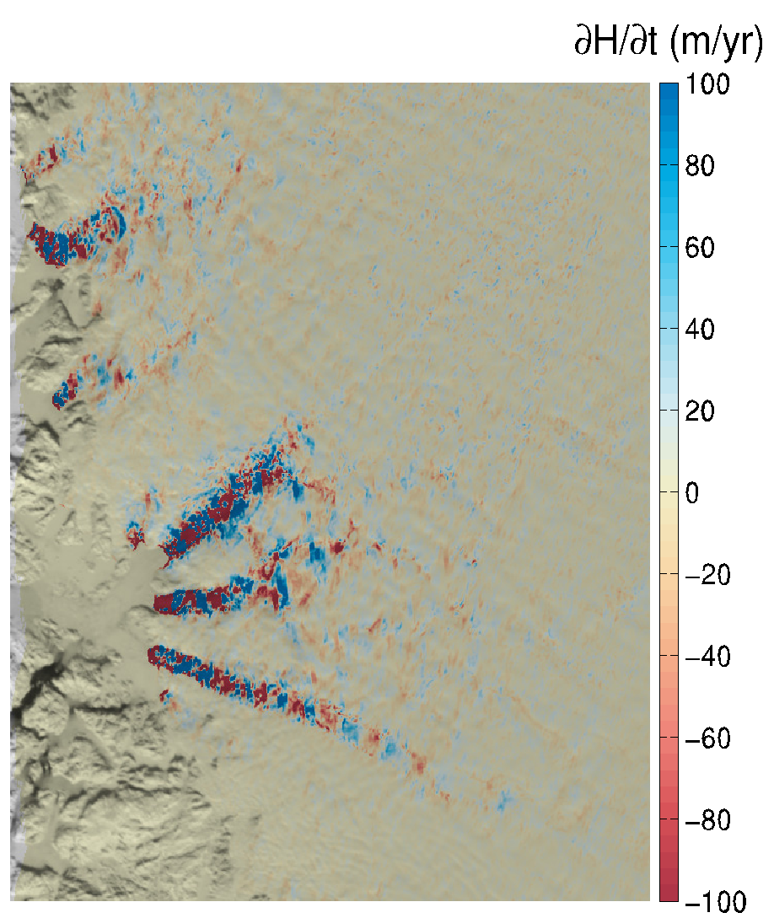

Satellite derived observation of the surface
Infer shape of the bedrock underneath (bed height)
Ice surface elevation
Ice speed
Basal topography
Thinning
AI

Slide 10
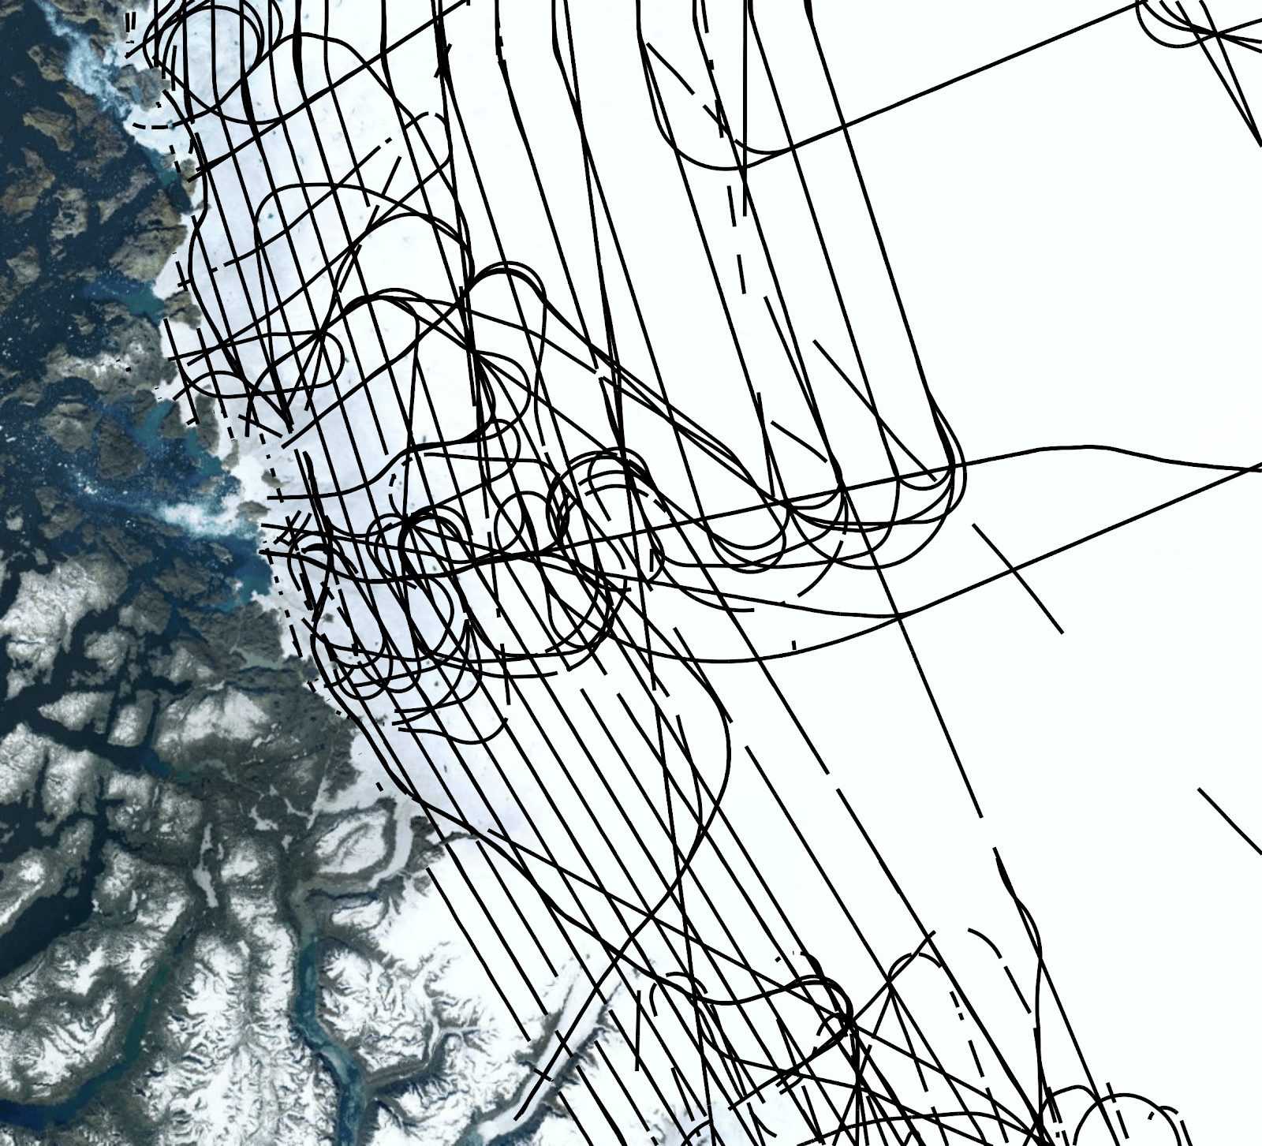
Input data: 2D grids (150 m resolution, HDF5 format)
Ice surface elevation [m] (surf_elv)
Ice flow velocity vectors [m/yr] (surf_vx, surf_vy)
Ice thinning rates [m/yr] (surf_dhdt )
Snow accumulation [m/yr] (surf_SMB)
Coordinates of cell centers [m]: surf_x, surf_y
Training set: 1D flight line data (along lines)
track_bed_training
1st column: x [m]
2nd column: y [m]
3rd column: bed height [m]
For each point (x,y)
Find corresponding pixel in input grids
Prepare input data
Infer bed height
Compare to measured bed height
Ice surface elevation
Ice speed
Thinning
AI

Slide 11
Testing set: 1D flight line data not used in training set
track_bed_testing
1st column: x [m]
2nd column: y [m]
We will compute the RMSE of the model to the measured bed height
Train CSV file with predicted bed height, in the same order as track_bed_testing
Ice surface elevation
Ice speed
Thinning
AI

Slide 12
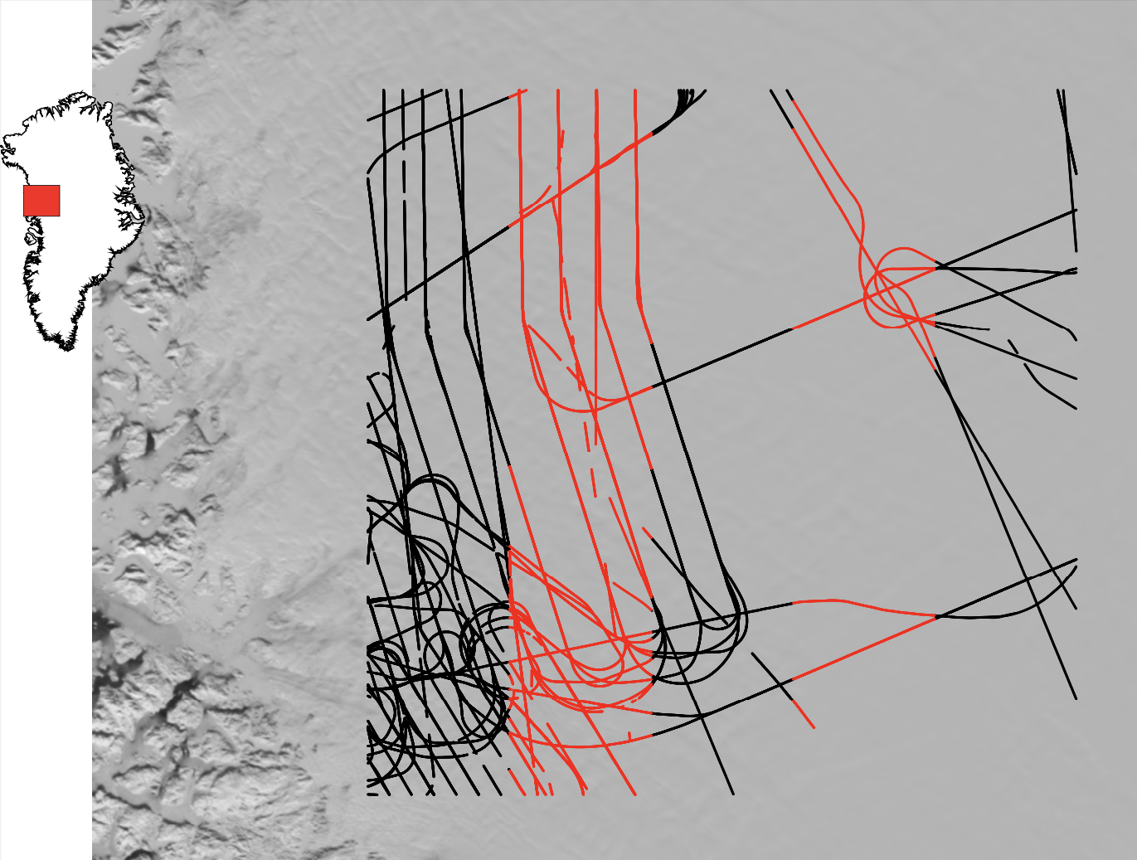
Training
(provided)
Testing
(hidden)
Training
(provided)
Testing
(hidden)
Training
(provided)

Slide 13
Data Preprocessing
1. Read the raw HDF5 dataset
2. Find the closest pixel index of track bed points from surf_x and surf_y
3. Find the values of surf_dhdt, surf_elv, surf_SMB, surf_vx, surf_vy
corresponding to the pixel index
5. Repeat the procedure for creating the test dataset

Slide 14
Data Preprocessing
Bilinear Interpolation
Nearest Neighbor

Slide 15
Data preprocessing
Given X and Y in track_bed_training data, find the closest pixel in other variables and use them as features
Training: X and Y in track_bed_training data -> (X, Y, surf_x, …) 9 variables for this point, train a model that takes the 9 variables as input and predict track_bed as output
Testing: X and Y in track_bed_testing data -> (X, Y, surf_x, …) 9 variables for this point, train a model that takes the 9 variables as input and predict track_bed as output
Data Preprocessing:
Select an initial point from surf_x and surf_y. Since, pixels are 150m apart from each other, we can calculate as (x1-x)/150= p, where p in the index number. For surf_x it’s row ( p1) and surf_y it’s column (p2). x1 is the point from the track bed training data and x corresponds to surf_x and surf_y value
Find the corresponding values for of surf_vx, surf_vy and other features for the point (p1,p2)
Merge those columns and create the dataset in CSV format

Slide 16
Machine Learning Model
Basic Regression Analysis Models
Deep Learning Models:
Dense Layer-based Regression
LSTM Regression
Dense Layer and LSTM Regression

Slide 17
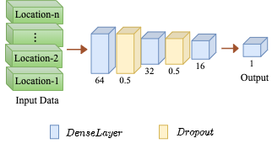
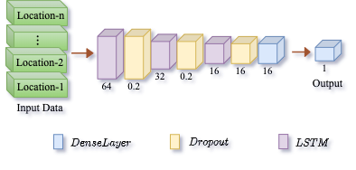
Deep Learning Model
Fig1: Visualization of the Dense Layer based model.
Fig2: Visualization of the LSTM model

Slide 18
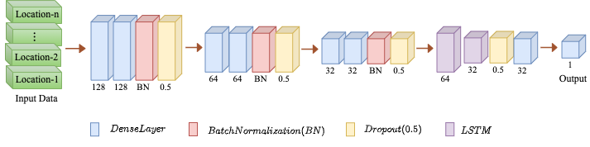
Deep Learning Model
Fig3: Visualization of the integrated Dense Layer and LSTM model

Slide 19
Comparison of Results
Model | RMSE | MAE | R²
Gradient Boosting | 136.93 | 100.63 | 0.113
XGBoost | 135.18 | 97.06 | 0.135
Lasso Regressor | 147.30 | 106.79 | -0.026
Dense | 387.98 | 364.02 | -6.110
LSTM | 556.09 | 493.71 | -13.620
Dense+LSTM | 57.30 | 55.04 | 0.840

Slide 20
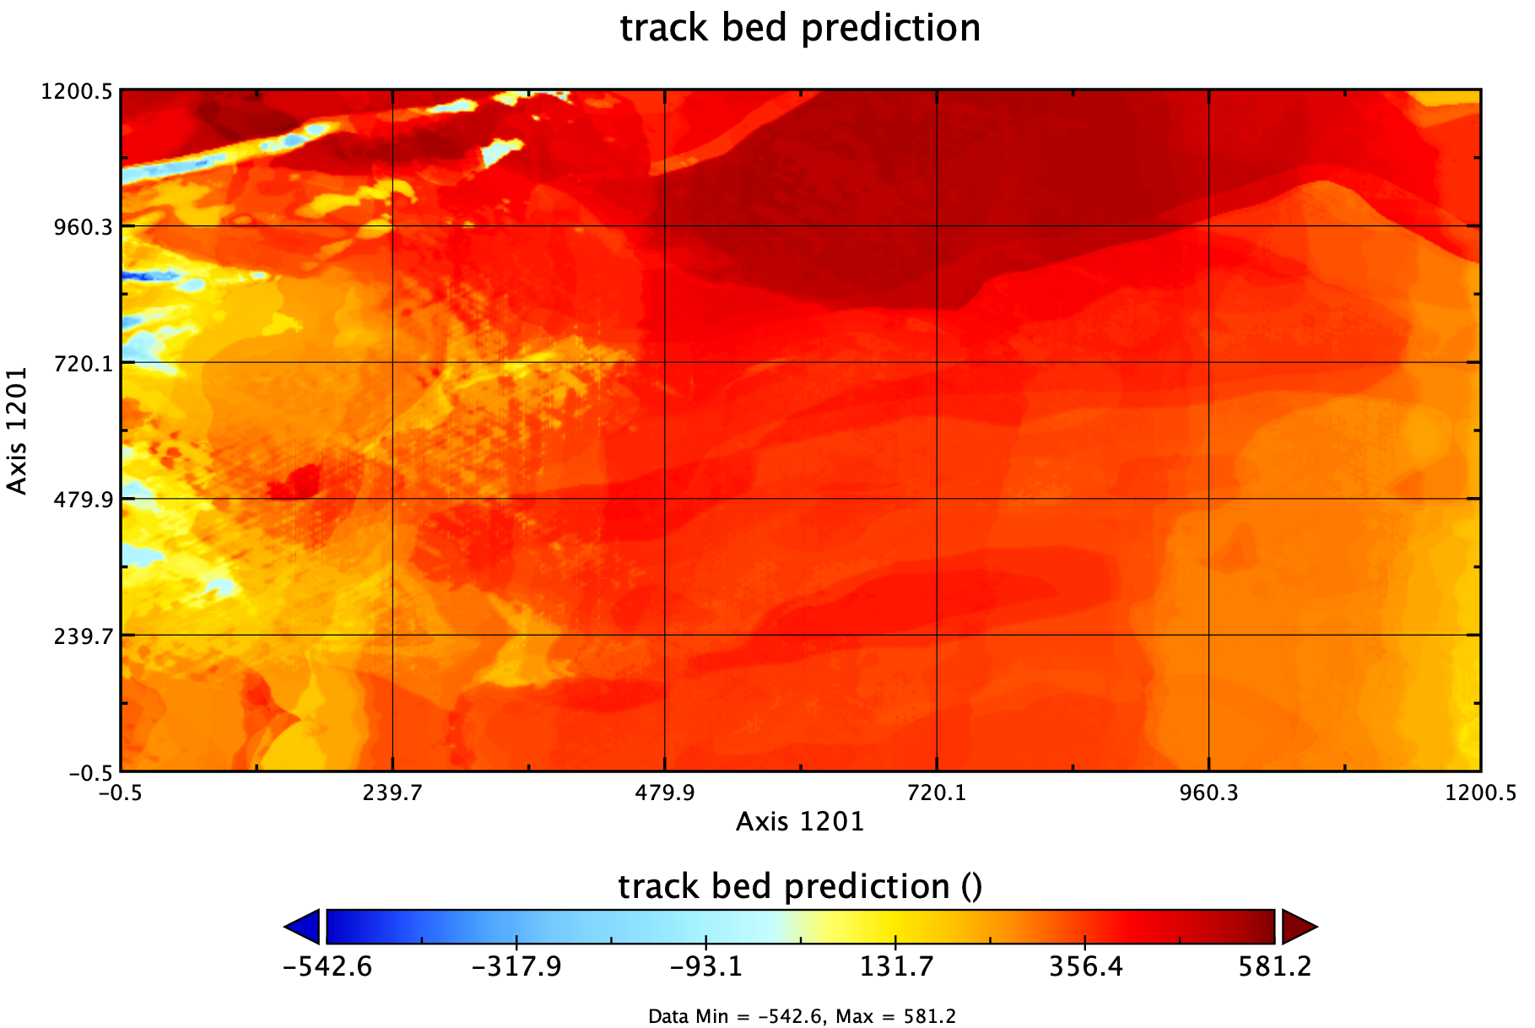
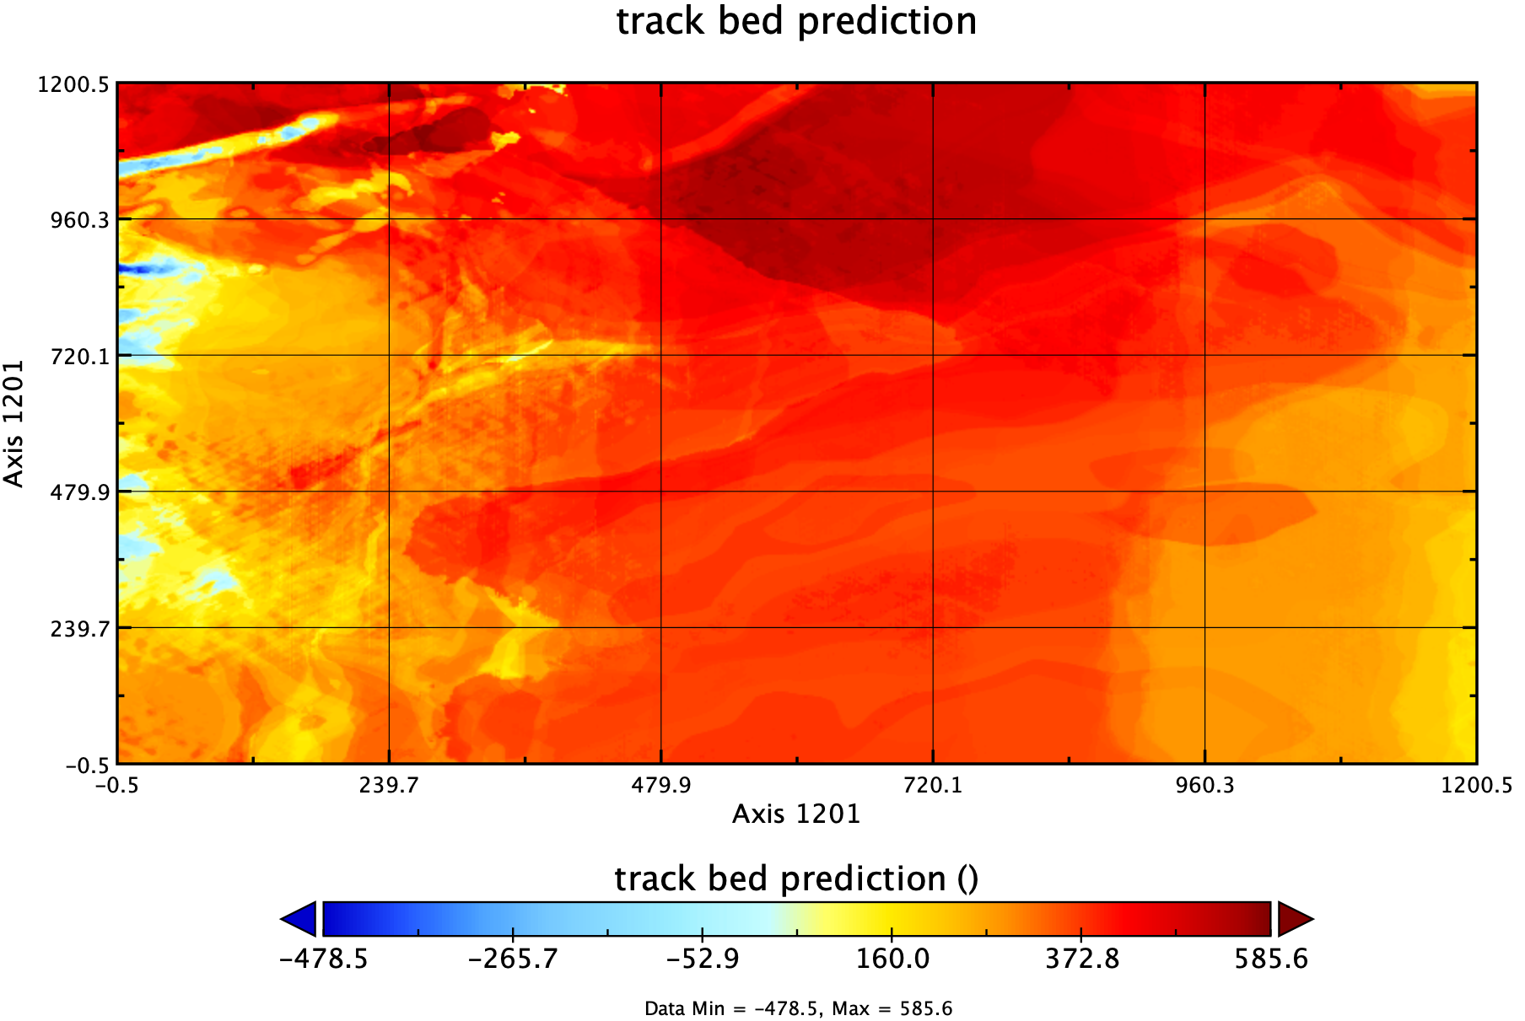
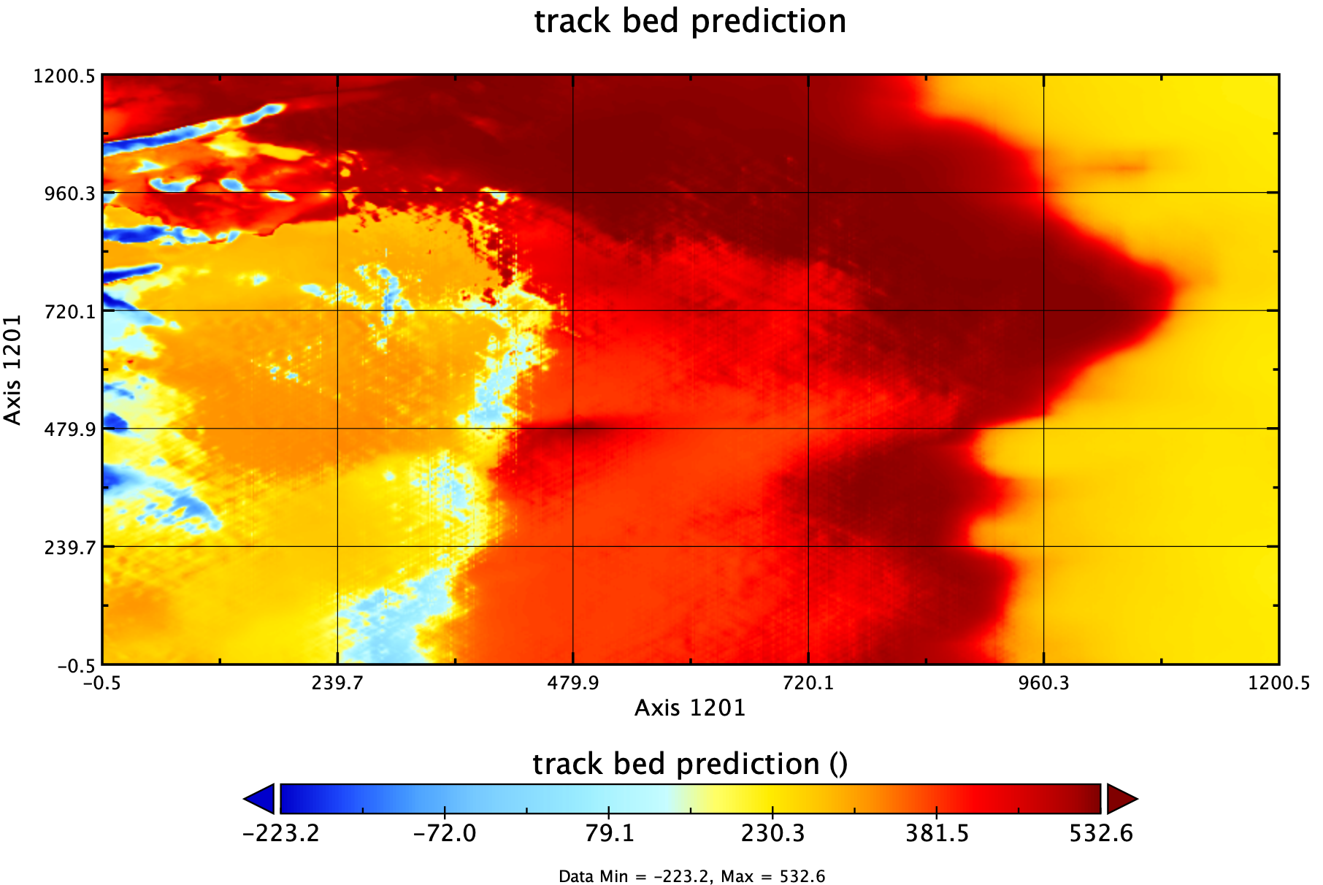
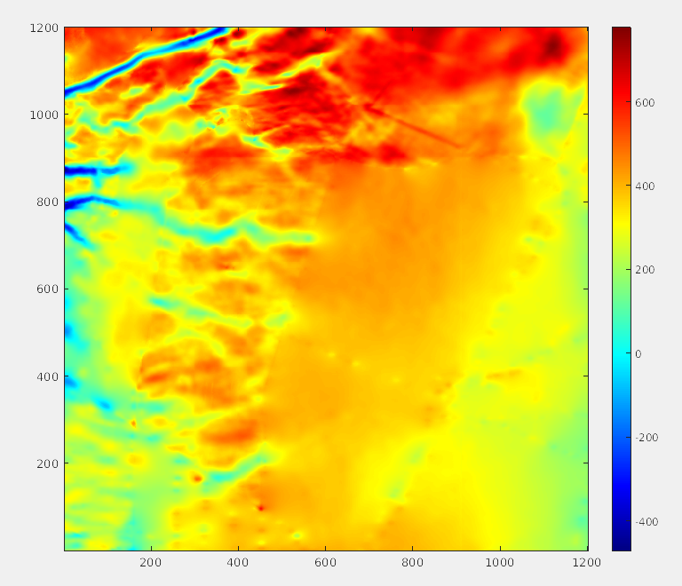
Predicted Bed Map for a 2D Area
Fig: Predicted ice bed height using (a) Gradient Boosting, (b) XG Boosting, (c) CNN-LSTM, (d) physics

Slide 21
Challenges of the Data Set
It’s an incomplete data set problem
We need to find out the missing data
Model needs to predict bed topography values along each pixel points
The bed topography prediction should bump , mountains and canons to make a reliable 3D model

Slide 22
Additional info: TEDx talk from our collaborator (Dr. Mathieu Morlighem)

